Slide 1
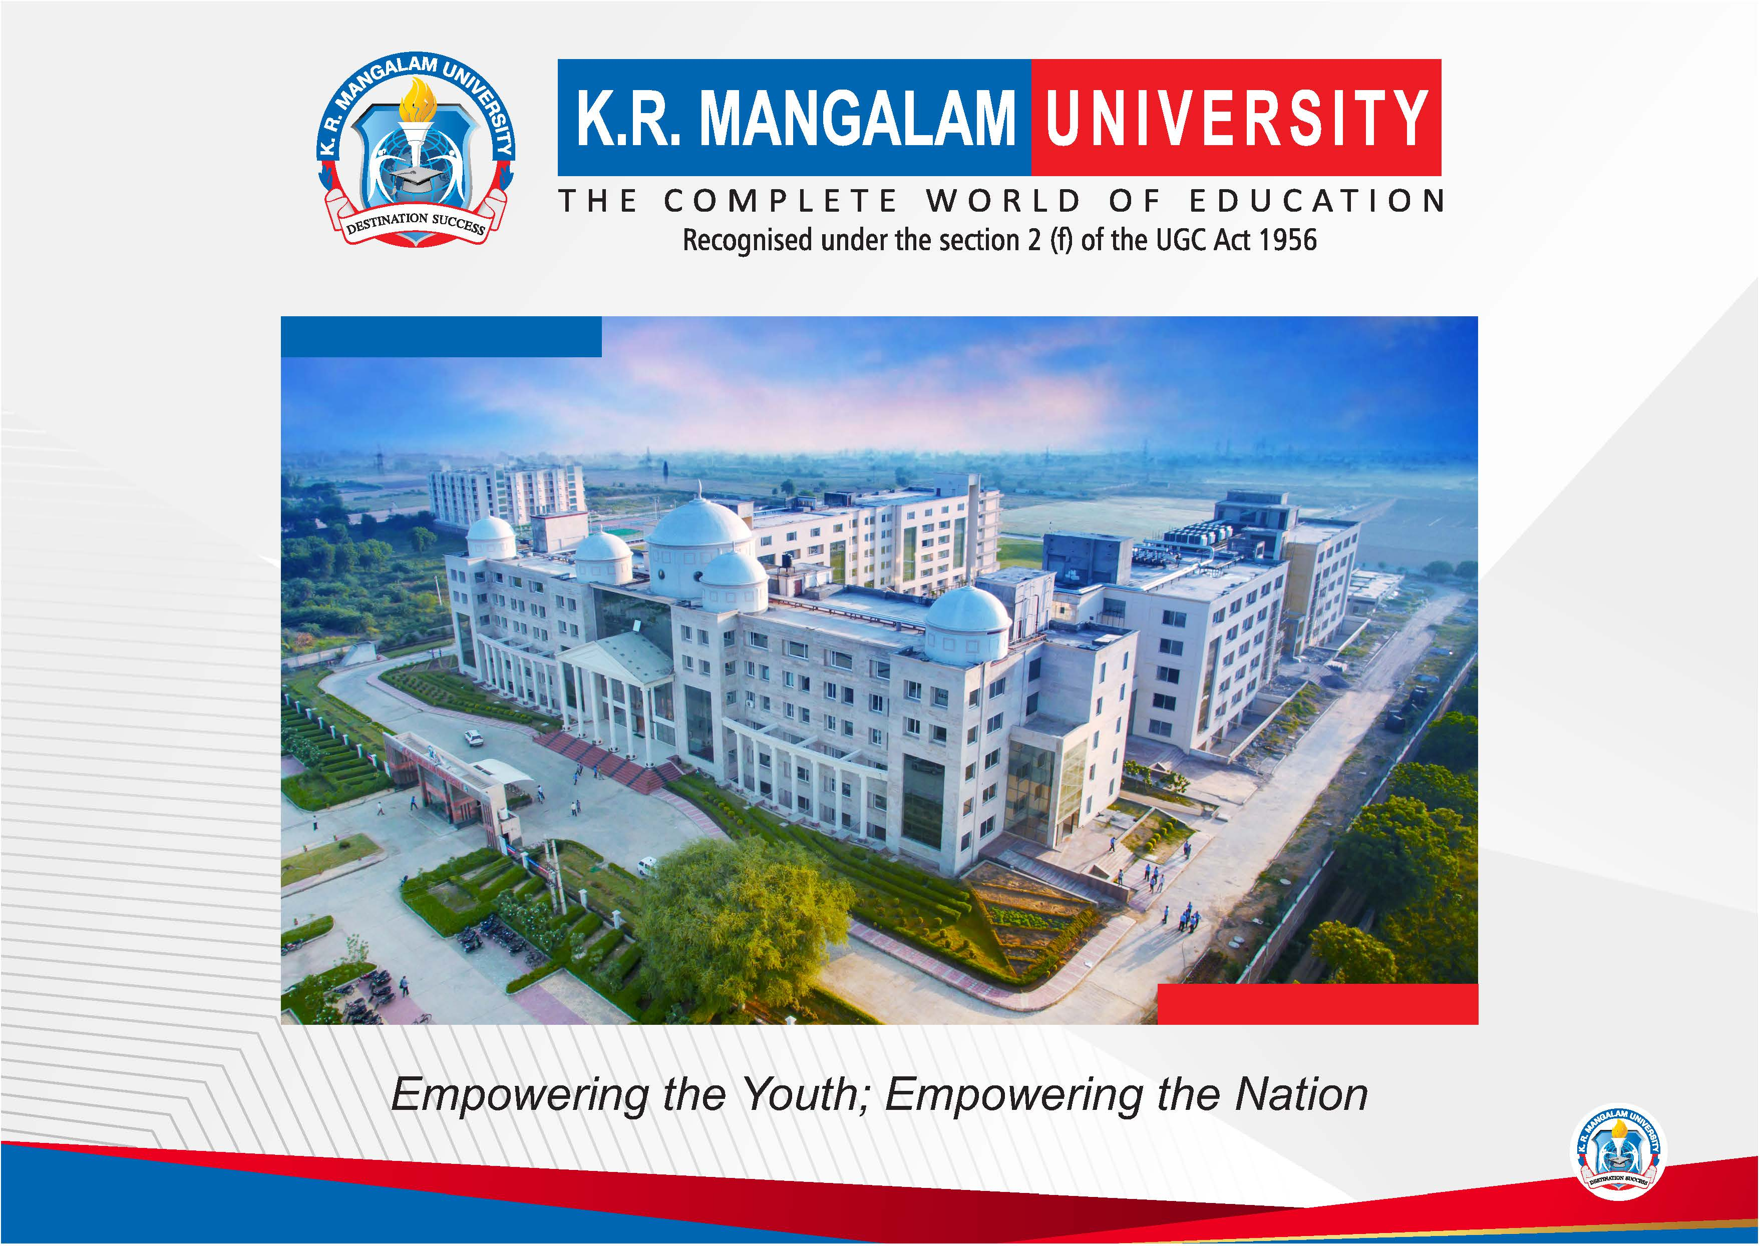

Slide 2


PREDICTIVE MAINTENANCE FOR AUTONOMOUS ELECTRIC BUSES USING REAL-TIME
SENSOR DATA AND MACHINE LEARNING
Pre-Final Year Project Synopsis
Submitted by
ROLL NO. | NAME
2401011487 | Rounit Kumar
2401011485 | Prince Kumar Gupta
2401011483 | Naman Bharadwaj
2401012482 | Shantna Kumar
Faculty Mentor: Mrs. Kriti Sharma
Notes:
New Courses replaced with New Programmes

Slide 3
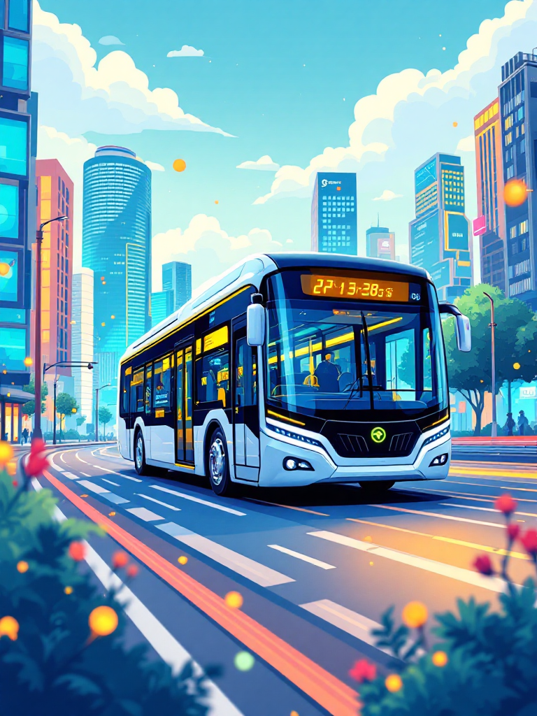

Introduction
Rapid urbanization has increased the need for efficient, safe, and sustainable public transportation, driving the adoption of Autonomous Electric Buses (AEBs) due to their zero emissions and improved safety.
AEBs consist of complex mechanical, electrical, and electronic systems, making maintenance a critical challenge with traditional reactive and scheduled approaches causing downtime and high costs.
Predictive Maintenance (PdM) addresses these issues by forecasting potential failures in advance, enabling proactive maintenance decisions.
Real-time sensor data (battery health, temperature, vibration, braking, and energy usage) combined with Machine Learning techniques allows early detection of faults and component degradation.
The proposed research aims to develop an intelligent ML-based predictive maintenance framework to improve reliability, safety, operational efficiency, and component lifespan of autonomous electric buses.
Notes:
New Courses replaced with New Programmes

Slide 4
Specific Objectives
Optimize Maintenance Schedules
Shift from reactive to proactive maintenance, reducing downtime and operational costs for autonomous electric bus fleets.
Enhance Component Lifespan
Identify potential failures in critical components like batteries, motors, and sensors, extending their operational life through timely interventions.
Improve Safety & Reliability
Mitigate the risk of unexpected breakdowns, ensuring safer operations for passengers and reducing the likelihood of accidents.
Develop Data-Driven Insights
Utilize machine learning algorithms to analyze sensor data, providing actionable insights into bus performance and health trends.
Notes:
New Courses replaced with New Programmes

Slide 5
Key Features
Real-time Sensor Data Integration
Collection and analysis of vast amounts of data from various bus components, including battery health, motor performance, and environmental conditions.
Advanced Machine Learning Models
Utilizing AI to identify complex patterns and anomalies in sensor data, predicting potential failures with high accuracy.
Predictive Analytics Dashboard
Intuitive visual interfaces for fleet managers to monitor bus health, receive proactive alerts, and schedule maintenance efficiently.
Automated Maintenance Recommendations
System-generated suggestions for preventive actions, parts replacement, and servicing, optimizing resource allocation.
Notes:
New Courses replaced with New Programmes

Slide 6
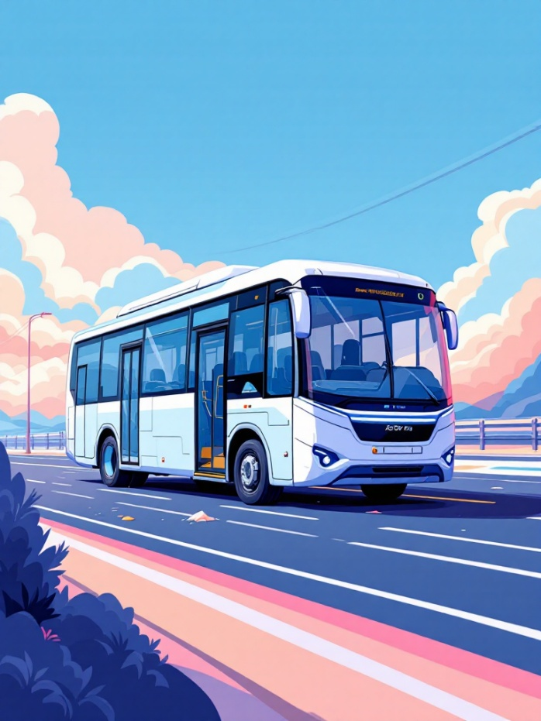
Challenges & Insights
The Core Problem: Unpredictable Failures
Autonomous Electric Buses (AEBs) introduce new maintenance challenges. Traditional time-based or reactive maintenance strategies are inefficient and costly, leading to:
Increased operational downtime and service disruptions.
Higher repair costs due to catastrophic failures.
Compromised safety and reliability for passengers.
Our research aims to overcome these issues by proactively identifying potential failures before they occur.
"Predictive maintenance is not just about fixing things; it's about optimizing performance and trust in autonomous systems."
Notes:
New Courses replaced with New Programmes

Slide 7
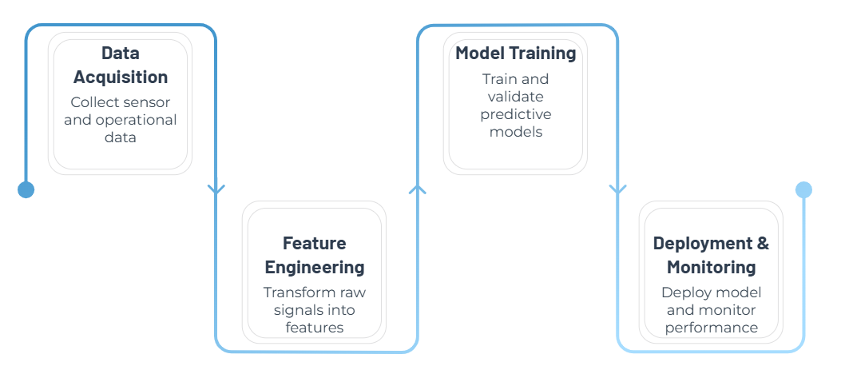
Methodology: A Data –Driven Approach
Our methodology combines robust data collection with sophisticated machine learning techniques to create a comprehensive predictive maintenance framework for autonomous electric buses.
Notes:
New Courses replaced with New Programmes

Slide 8
Data & Resources:Fueling Our Predictions
Comprehensive Data Sources
Vehicle Telemetry: Speed, acceleration, GPS coordinates, route data.
Battery Management Systems (BMS): State of charge, temperature, voltage, current, cycle life.
Motor & Powertrain Data: Torque, RPM, temperature, vibration levels.
Environmental Sensors: Ambient temperature, humidity, road conditions.
Historical Maintenance Logs: Past repair records, component replacements, failure patterns.
Technological Stack
Cloud platforms such as AWS and Azure provide scalable infrastructure for real-time sensor data storage, processing, and analytics, while MySQL stores structured sensor data, maintenance logs, and prediction results.
Python serves as the core development language, supported by NumPy and Pandas for efficient numerical computation, data cleaning, preprocessing, and analysis of real-time and historical sensor data.
Machine learning frameworks like TensorFlow, Scikit-learn, and Keras are used to build predictive models (including LSTM for time-series data), with Tableau and Power BI enabling real-time data visualization and monitoring dashboards.
Notes:
New Courses replaced with New Programmes

Slide 9
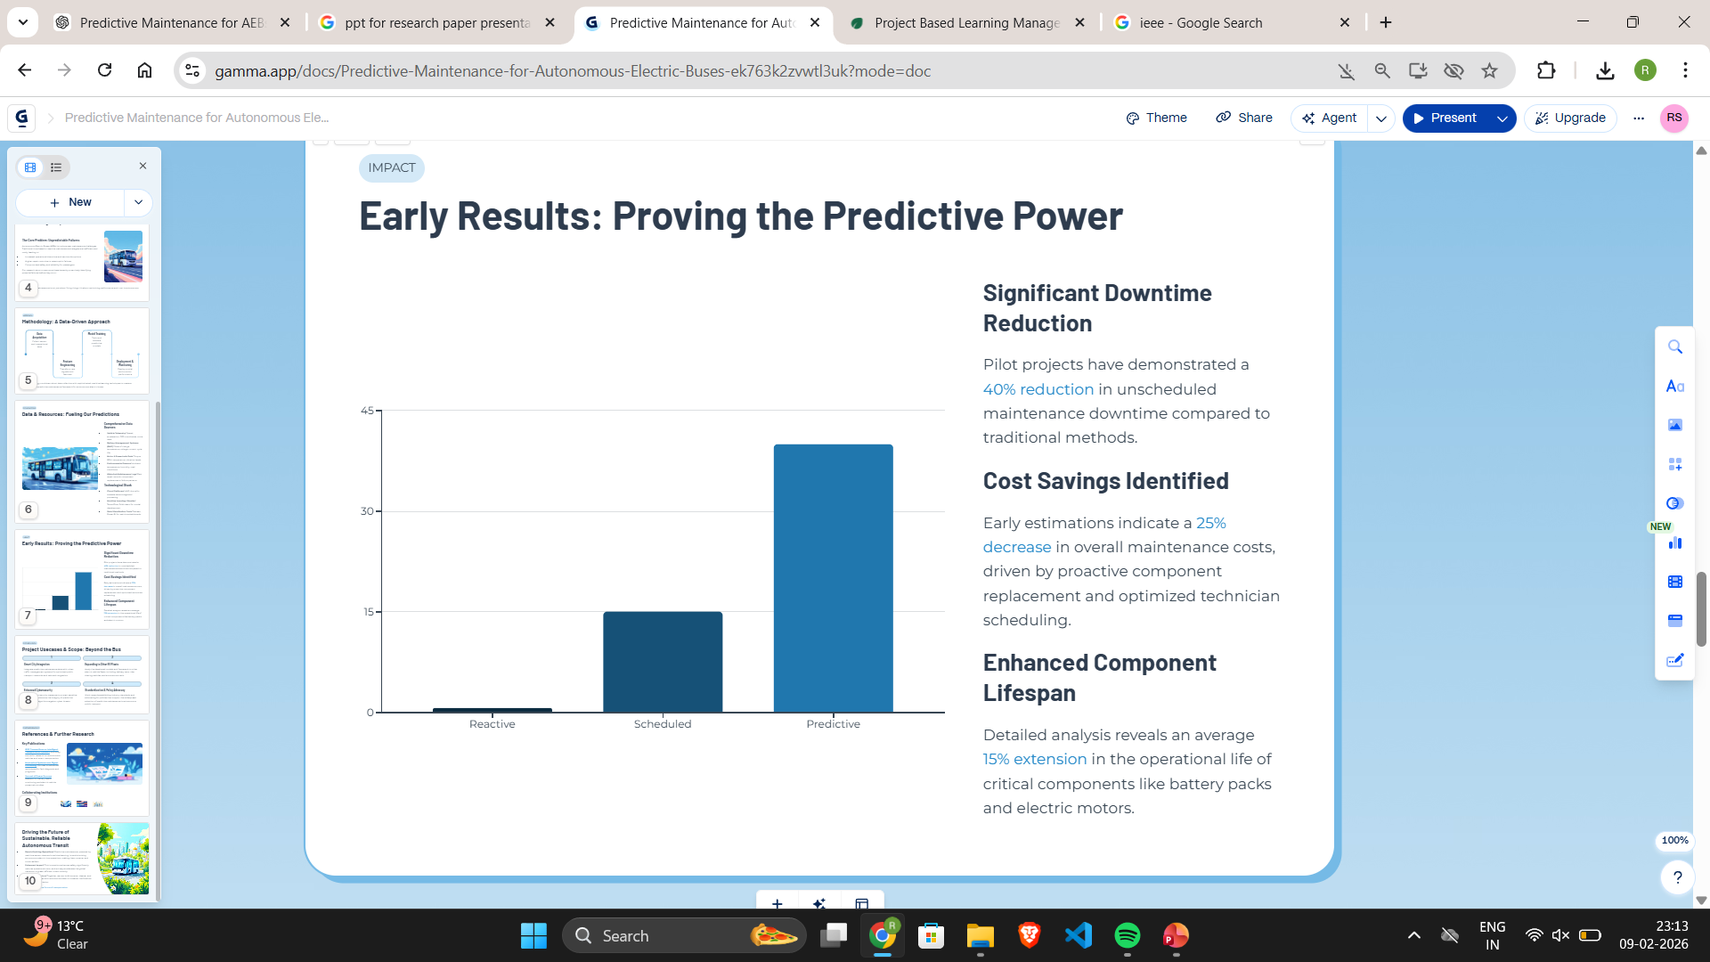
Early Results: Proving the Predictive Power
Significant Downtime Reduction
Pilot projects have demonstrated a 40% reduction in unscheduled maintenance downtime compared to traditional methods.
Cost Savings Identified
Early estimations indicate a 25% decrease in overall maintenance costs, driven by proactive component replacement and optimized technician scheduling.
Enhanced Component Lifespan
Detailed analysis reveals an average 15% extension in the operational life of critical components like battery packs and electric motors.
Notes:
New Courses replaced with New Programmes

Slide 10
Usecases & Scope: Beyond the Bus
Smart City Integration
Integrate predictive maintenance data with urban traffic management systems for optimized public transport networks and reduced congestion.
Expanding to Other EV Fleets
Apply the developed models and framework to other electric vehicle fleets, including delivery vans, ride-sharing vehicles, and autonomous taxis.
Enhanced Cybersecurity
Develop robust security measures to protect sensitive sensor data and ensure the integrity of predictive maintenance algorithms against cyber threats.
Standardization & Policy Advocacy
Work towards establishing industry standards and advocating for policies that support the widespread adoption of predictive maintenance in autonomous public transport.
Notes:
New Courses replaced with New Programmes

Slide 11

Conclusion-Driving the Future of Sustainable, Reliable Autonomous Transit
Revolutionizing Operations: Predictive maintenance, powered by real-time sensor data and machine learning, is revolutionizing autonomous electric bus operations, making them smarter and more resilient.
Enhanced Impact: This innovation enhances safety, significantly reduces operational costs, and actively accelerates the global transition to green, efficient urban mobility.
Collaborative Future: Together, we can build smarter, cleaner, and more reliable cities with autonomous electric buses at the forefront of urban transportation.
Notes:
New Courses replaced with New Programmes

Slide 12
References
IEEE Transactions on Intelligent Transportation Systems: A primary source for research on autonomous vehicles and smart transportation.
Mechanical Systems and Signal Processing: Focuses on advanced techniques for fault diagnosis and prognosis.
Journal of Power Sources: Relevant for battery health monitoring and electric vehicle powertrain studies.
S. Zhang, Y. Wang, and M. Liu, “Predictive Maintenance Using Machine Learning Techniques,” IEEE Access, vol. 7, pp. 163146–163161, 2019.
G. Zhao, C. Zhang, L. Ge, and J. Liu, “Research Advances in Fault Diagnosis and Prognosis Based on Sensor Data,” Sensors, vol. 17, no. 5, 2017.
Notes:
New Courses replaced with New Programmes

Slide 13
THANK YOU!

